Slide 1
M9
Security: PHP, MySQL

Slide 2
http://dev.mysql.com/doc/refman/5.0/en/security-guidelines.html
http://dev.mysql.com/doc/refman/5.0/en/faqs-security.html
http://dev.mysql.com/doc/refman/5.0/en/privilege-system.html

Slide 3
Introduction
Is it important?
  Maybe
    Depends on circumstances
      Benefit > cost

Slide 4
Introduction
Some Issues in Security:
  Network Security
  Secure Code
  Physical Security
  Culture and Sociology of Security
  Culture of Cracking and Hacking
  Theft
    Physical, Data, IP
  Maliciousness and Ego
    e.g., virus, worm
  Types of Attacks

Slide 5
Objective:
  fully protect ENTIRE server
    (not just MySQL server)
MySQL security:
  based on Access Control Lists (ACLs)
    for all connections, queries, and other operations
      that users can attempt to perform.
  supports SSL-encrypted connections
    between MySQL clients and servers.

Slide 6
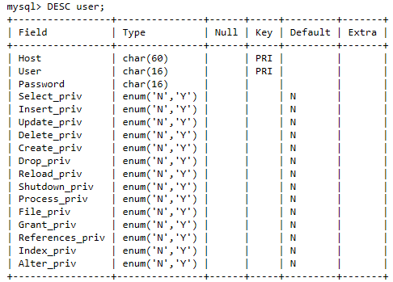
MySQL Verifies UserName / host / password combination:
    1st: permission to connect to the database
    2nd: checks if user / host combination has the right level of access to carry out that operation
      After connection, and before any operations are executed
    The User Table is the first table MySQL checks.
      All user/host/password combinations must be listed in this table before any access can be granted.
      To see table : DESC user;
User contains Various Permissions
e.g., Select_privPermission
(for running SELECT queries)
Insert_privPermission
(for INSERT statements)
“Y”: (allows operation to be done
in ALL databases in table)
[“N”: better to set to N
to restrict access to particular DBs]

Slide 7
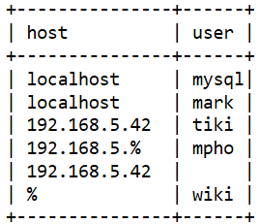
  The host and user are both needed
    to determine permission for connecting
    e.g., you can connect from one host but not necessarily from another
    SELECT host, user FROM user;
    Host:
      hostname of the machine
      IP
      wildcard (the % sign):
        e.g., user wiki can connect from any host
        rare
        e.g., user mpho can connect from any IP address beginning with 192.168.5.%
    User:
      Blank means anyone, e.g., anyone can connect from 192.168.5.42

Slide 8
  The host and user are both needed (cont.)
    e.g., Web applications usually allow access to DB server from:
      web server or
      localhost for small setups, where they're on the same machine.
  PASSWORD() function
    Encrypts password
      Encrypted password is stored.

Slide 9
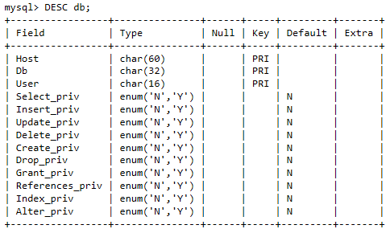
db Table
  sets permissions for specific databases
  DESC db;
    Host / User / database combo is important
      not password as in User Table
    if user doesn't have permission to do an operation MySQL checks here
      [a particular database permission will override the general user table permissions]
      Recommend:
        Deny global permissions
        grant on database-level only.

Slide 10
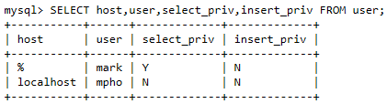
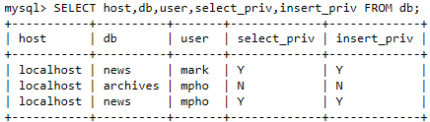
Mark didn't have permission to insert in User Table but does in db Table (news db)
Mpho now has select and insert privilages in the news db

Slide 11
HOST Table
  Checked if db Table has values for database and user, but not for host
  Determines permissions
    If host left blank .
    Tells you your privileges for a particular database
      based on which host you are accessing
  DESC host;

Slide 12
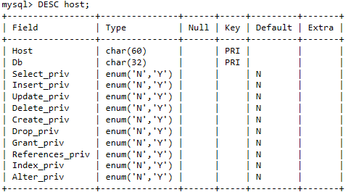
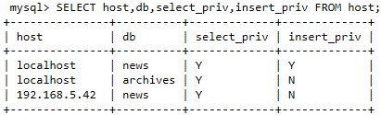
Below:
  e.g. user from local host has select and insert privilages on news db. But someone from 192.168.5.42 only has select privilages

Slide 13
tables_priv table
  Lets you assign user permission on Table level
columns_priv table
  Lets you assign user permission on column level
DESC tables_priv;
DESC columns_priv;

Slide 14
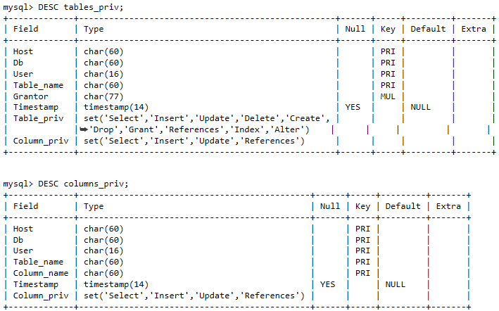

Slide 15
order of precedence of the tables:
USER → DB/HOST → TABLES_PRIV → COLUMNS_PRIV
  checks user table
    if permission is NOT granted check db and host tables
      if need more confirmation then check tables_priv
        Then columns_priv tables.
  Con: performance cost
    Checks before each operation!

Slide 16
2 ways to assign privileges:
  directly manipulate tables
    Using INSERT, UPDATE and DELETE statements
      MySQL will have to be reloaded
      or the privileges flushed
        e.g.using FLUSH PRIVILEGES statement
    PASSWORD() function
      To add a record directly to the password field
  GRANT statement (easier)
    GRANT privilege ON table_or_database_name TO user@hostname IDENTIFIED BY 'password'.

Slide 17
In class exercise: List and explain privileges
Database and Table names in a GRANT statement:
  *.*
    All tables in a database
  *
    All tables in the current database
  dbname.*
    All tables in the named database
  dbname.tbname
    The named table in the named database

Slide 18
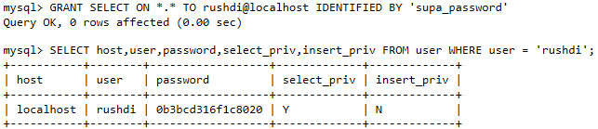
e.g. Below:
  *.* used therefore record only in the user table
  Password was encrypted

Slide 19
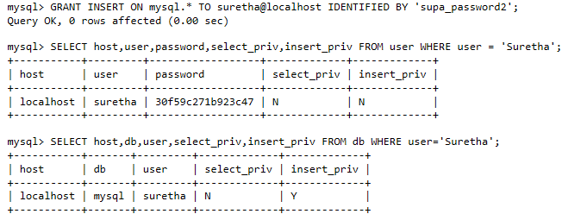
Records added to user and db tables
  [mysql.* used]

Slide 20
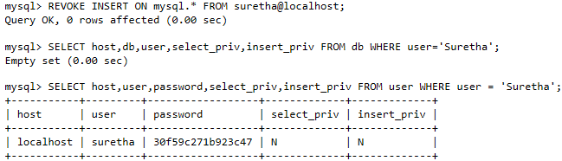
REVOKE statement
  Takes away permissions
  e.g., Below: record in db table removed but still in user table
    There for can still connect but doesn't have permission to select or insert

Slide 21
Guidelines:
  Never give anyone access to the user table
    except MySQL root accounts
    b/c it stores the real password (i.e., encrypted password)
  Learn the MySQL access privilege system.
  Grant minimal privileges.
    Never grant privileges to all hosts.
    Use Show Grant (to check which accounts have access to what).
    Use Revoke to remove unnecessary privileges
  Make sure root user has a password
      mysql -u root should not be able to login (by default it can)
  DON'T put plain-text passwords in database
    Sol'n: Use one-way hashing function and store the hash value
      e.g., MD5(), SHA1()

Slide 22
Guidelines: (cont.)
  NO dictionary passwords
    Use min. 8 mixed characters / numbers / symbols
  Use a firewall.
    protects you from at least 50% of all types of exploits in any software.
    Put MySQL behind the firewall
  Try to scan your ports from the Internet using a tool such as nmap.
    port 3306
      MySQL uses it by Default.
      SHOULDN'T be accessible from untrusted hosts.
    To check if MySQL port is open: telnet server_host 3306
      If you get a connection and some garbage characters, the port is open
        Sol'n: close on firewall or router
      If telnet hangs or the connection is refused, the port is blocked

Slide 23
Guidelines: (cont.)
  DON'T transmit unencrypted data
    use encrypted protocol (e.g. SSL or SSH).
    use SSH port-forwarding
      to create an encrypted (and compressed) tunnel
  Use tcpdump and strings utilities.
    To see if MySQL data streams are unencrypted, e.g.:
      tcpdump -l -i eth0 -w - src or dst port 3306 | strings
        non plain text data does not guarantee data is encrypted
        [better than nothing]

Slide 24
Guidelines: (cont.)
Possible to replace plugins and modify their capabilities if:
  You have access to modify the plugin directory
    i.e., value of plugin_dir system variable
  my.cnf file
    specifies the location of plugin directory
    .
Passwords can appear as plain text in SQL statements
  e.g., in CREATE USER, GRANT, SET PASSWORD, statements invoking PASSWORD()
  If logged, password visible to those with access to logs.
    e.g., general query log, the slow query log, and the binary log
    Sol'n: Put log files located in directory restricting access to only server and DB administrator.

Slide 25
Guidelines: (cont.)
master.info file
  Stores password for the replication master
    Stored by Replication slaves
  Sol'n: restrict access to database administrator.
Database backups can have passwords in tables or log files
  Sol'n: restricted access mode

Slide 26
MySQL uses passwords in two phases of client/server communication:
  When a client attempts to connect to the server, there is an initial authentication step in which the client must present a password that has a hash value matching the hash value stored in the user table for the account that the client wants to use.
  After the client connects, it can (if it has sufficient privileges) set or change the password hashes for accounts listed in the user table. The client can do this by using:
    PASSWORD() function to generate a password hash, or by using the GRANT or SET PASSWORD statements.

Slide 27
register_globals
Used before PHP 5.4.0
Turned off / on through directive
  ON: will inject your scripts with variables
    e.g., request variables from HTML forms.
    people use variables without knowing definitely where they come from.
    variables defined in script get mixed up with request data sent by users
Danger: PHP doesn't require variable initialization
  Makes writing insecure code easier
Notes:
http://ca2.php.net/manual/en/security.globals.php

Slide 28
register_globals (cont.)
<?php
if (authenticated_user()) {
$authorized = true; // define $authorized = true only if user is authenticated
}
// Because we didn't first initialize $authorized as false, this might be
// defined through register_globals, like from GET auth.php?authorized=1
// So, anyone can be seen as authenticated!
if ($authorized) {
include "/highly/sensitive/data.php";
}
?>
Notes:
http://ca2.php.net/manual/en/security.globals.php

Slide 29
Magic Quotes
Removed in PHP 5.4.0
Pro:
  convenience for amatures
  Prevent syntax errors
Prob: Different content has different special chars and ways to escape
  A successful method in one context could have a side effect elsewhere.
  won't stop an attacker from harming database
Sol'n: escape using PHP addslashes()
  Escape Data where you need to, and for the domain in which it will be used.
Notes:
Data should be escaped where you need it escaped and for the domain in which it will be used. (mysql_real_escape_string -- NOT addslashes! -- for MySQL (and that's only unless you have a clue and use prepared statements), htmlentities or htmlspecialchars for HTML, etc.) Anything else is doomed to failure.

Slide 30
Port Forwarding (AKA Tunnelling)
  Intecepting data meant for one IP/Port combination and sending it to another one
    Usually done by program running on host
    Can also be done by intermediate hardware
      e.g., router, proxy server, firewall
  Packets have to be rewritten
  Can hide what services are running on network by:
    Using 1 IP address for all incoming traffic
    And dropping traffic unrelated firewall's services
  Pros:
    saves Public IP addresses
    Limit access in and out of network
    Hide services and servers
    Transparent to sender
Notes:
http://whatismyipaddress.com/port-forwarding

Slide 31
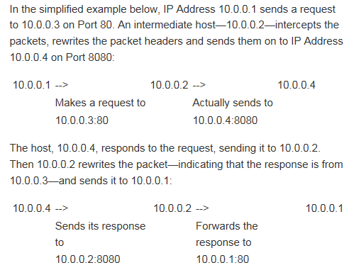
Port Forwarding (AKA Tunnelling) (Cont.)
Notes:
http://whatismyipaddress.com/port-forwarding

Slide 32
Network
  A communications system
    enabling computer users to share computer equipment, application software, and data, voice, and video transmissions
  Contains computers joined by communications cabling or sometimes by wireless devices
Local area network (LAN)
  A network of computers in relatively close proximity

Slide 33
SSL (Secure Sockets Layer)
Developed by Netscape (1994)
For encryption and identity assurance.
  makes it hard to intercept and read data
    data passed between the web server and browser is private and secure
works through a combination of programs and encryption/decryption routines
  that exist on the:
    web server and
    web browsers
Notes:
https://www.evsslcertificate.com/ssl/description-ssl.html

Slide 34
SSL (Secure Sockets Layer) (cont.)
SSL certificate
  digital document that verifies security & authenticity of interaction
  installed on a web server
    to identify organisation using it to encrypt data
Notes:
https://www.evsslcertificate.com/ssl/description-ssl.html

Slide 35
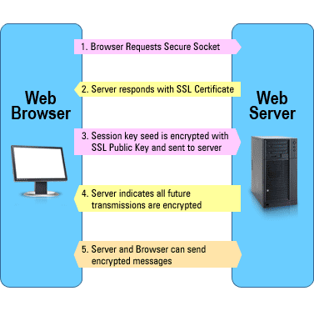
SSL (Secure Sockets Layer) (cont.)
SSL Interaction
Browser checks certificate
  makes sure it is the real site
Determine encryption types that both (browser and server) can use to understand each other
Browser and Server send each other unique codes
  used encrypting data
browser & server start talking using the encryption
  browser shows the encrypting icon
  pages are processed secured
Notes:
https://www.evsslcertificate.com/ssl/description-ssl.html

Slide 36
SSL (Secure Sockets Layer) (cont.)
cryptography
asymmetric algorithms (AKA PKI)
  use one key for encryption of data and separate key for decryption.
  more secure than symmetric.
    even if the encryption key is hacked they still need to hack the other key
  Pro: both sides can initiate a transaction without ever having met.
    Because of public and private key pair.
      public key:
        public knowledge
        used for encryption
      private key:
        Stays secret
        used for decryption.
  Con: encryption/ decryption can take up to 1000 times the processing
Notes:
https://www.evsslcertificate.com/ssl/description-ssl.html

Slide 37
SSL takes advantage of the strengths of both public-key and symmetric-key encryption technologies.
  Public-key technologies:
    securely authenticate clients and servers and
    exchange trade secret symmetric keys used in the encryption sessions.
    When a browser points to a secured domain, a secure sockets layer handshake:
      authenticates the server and the client and
      establishes an encryption method and
      a unique session key.

Slide 38
SSL uses digital certificates that act as digital documents that will attest to the binding of a public key to an individual or other entity. They provide verification of the claim that a specific public key does, in fact, belong to the specified entity.
These certificates use X.509 standards to validate identities. X.509 certificates contain information about the entity, including public key and name. The role of the certificate authority then is to validate this certificate.

Slide 39
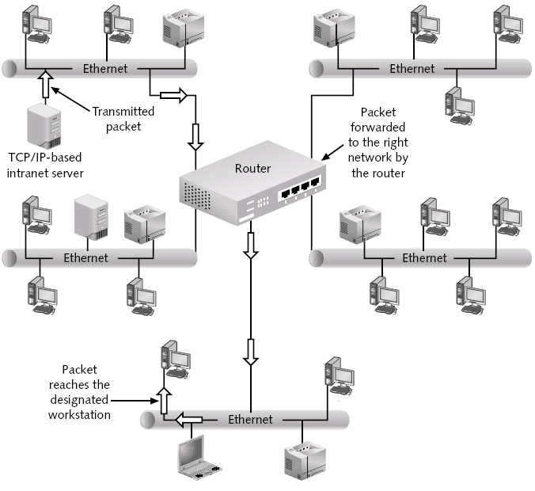

Slide 40
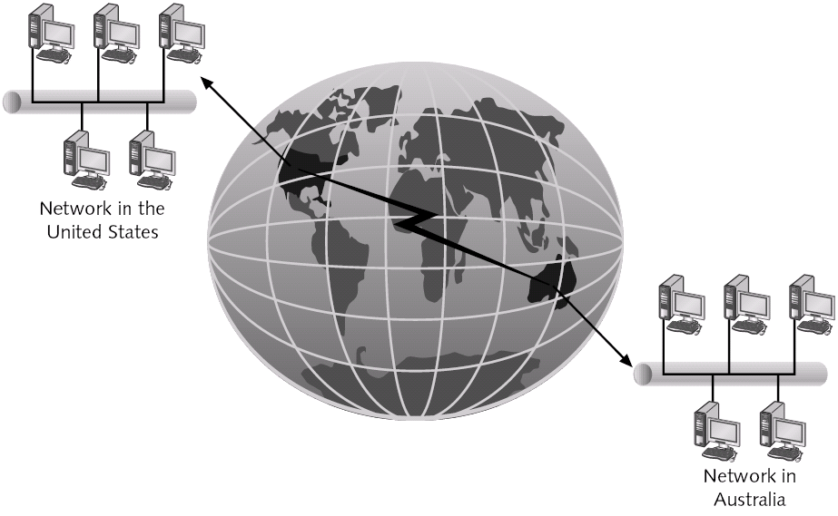

Slide 41
Internet:
  reduces barrier to competition created by:
    Space
    Time
    and information asymmetries
  Allows for personalization of communication and marketing of information.
    By:
      bringing vast networks of users together
      permitting interactive communications between senders and receivers
  has well defined structure & governance process.

Slide 42
  IP
    Two versions: IPv4 and IPv6
      IPv4 is used by default on most networks b/c
        older / established
        Well understood
  Transmission Control Protocol (TCP).
    most common protocol used in addition to IP
    protocol that uses a set of rules to exchange messages with other internet points
      at the data packet level.
    Connection Oriented: ensures reliable, flow-controlled data packet delivery.

Slide 43
History of the Internet…contd.
DARPA subsequently began packet switching.
  Packet switching
    method of transmitting data by:
      breaking it up into small segments or packets
      and sending the packets individually in a stream.
    packets not necessarily sent together
      rather are disassembled, transmitted separately, and then reassembled when they arrive at their destination.
  This is based on the TCP/IP protocol.
    protocol
      a set of rules used in sending and receiving data during communication.
    Need b/c:
      Bought systems from different vendors
      Make telecommunications robust to attack

Slide 44
Internet Technologies and Applications
World Wide Web
  A form of a client-server network
    connecting web clients to web servers.
    Versions include web 2.0 and web 3.0.

Slide 45
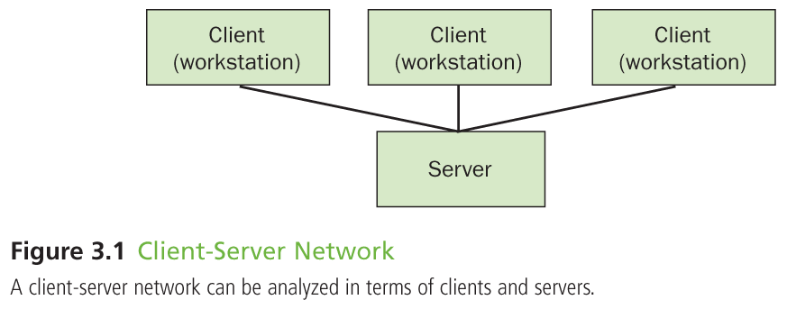
Client-Server Network
Notes:
LO #3

Slide 46
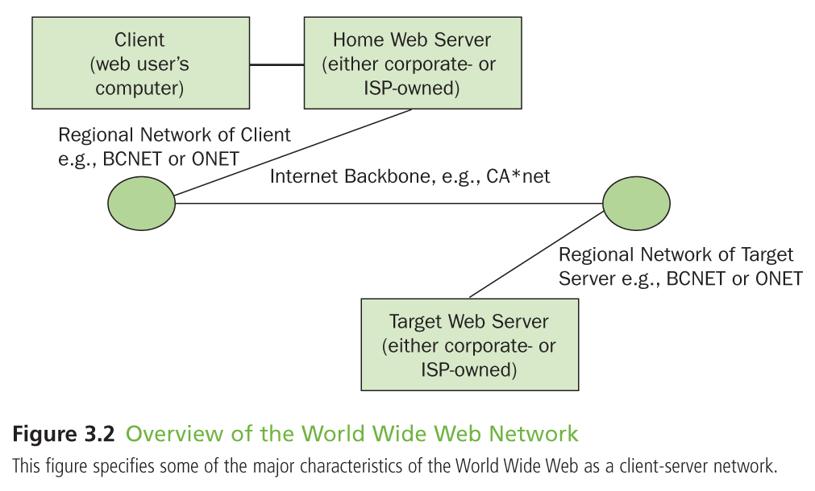
Overview of the World Wide Web Network
Notes:
LO #3

Slide 47
Internet Technologies and Applications
Hypertext mark up Language (HTML)
  specialized coding language used to encode content so it can displayed in a web browser
    using source code
      a format in which a program is written that can be read by humans and that is then converted into a different format that the computer can recognize.
  HTML describes the content only in terms of how it is to be displayed and interacted with
Web browser
  software with a user-friendly, graphics-capable interface that enables users to connect to and navigate websites on the internet.
  1st one Mosaic (1993)

Slide 48
Internet Technologies and Applications
Hypertext Transfer Protocol (HTTP)
  set of rules used in exchanging files (such as text, graphics, sound and video) for display on the world wide web.
Extensible Mark up language (XML)
  mark up language similar to HTML
    both contain symbols to describe the contents of a page or file
    XML describes the content in terms of what data is being included.
      HTML describes the content only in terms of how it is to be displayed and interacted with

Slide 49
Internet Technologies and Applications…contd.
Intranets
  network that is:
    internal to an organization
    uses internet technology.
  initially conveyed messages to employees
  Now used by employees to input messages into corporate applications
  now support and facilitate ebusiness
    enabling employees to work from outside their offices, or in client offices and collaborate with management and important constituents.

Slide 50
Internet Technologies and Applications…contd.
Extranets (e.g. p. 63—Hyundai)
  Networks that are:
    available to users inside and outside of a company
    and use internet technology.
  connect outside parties
    such as suppliers and customers, and are used to streamline supply chains
      Used to place purchase orders by suppliers
      Used to deal with inquiries about product availability, delivery times and customer concerns
      Used to implement vendor managed inventory applications.
  Help to reduce costs, improve timing of business applications and foster key business relationships.

Slide 51
Many extra/intranets on the Internet to save cost of:
  Broadband network capability
  Dedicated phone lines
  Network equipment
  Con:
    Security
      Hacker only needs to find site and hack a single user ID and password to enter.
        Harder to do if it was a corporate network
      Sol’n: Virtual Private Network

Slide 52
Internet Technologies and Applications…contd.
Virtual Private Networks (VPN)
  a secure and encrypted connection between two points across the internet.
    transfer information by encrypting the data in IP packets and sending the packets over the internet by a process called Tunnelling.
      Tunnelling
        process under which data packets are transmitted over the internet by including an additional header that establishes its route (Tunnel) through the internet
        -adds assurance b/c you know where packets are and where they are going.
  used to develop extranets making the internet a more viable business system.

Slide 53
VPNs reduce costs:
  Networking
  Staff
VPNs faster for international networks
  Alternative: waiting for links to be established by carriers
How Data travels on VPN:
PC → firewall (data encrypted) → Your ISP → tunnels → recipient’s ISP → recipient’s firewall (decrypted) → recipient’s PC

Slide 54
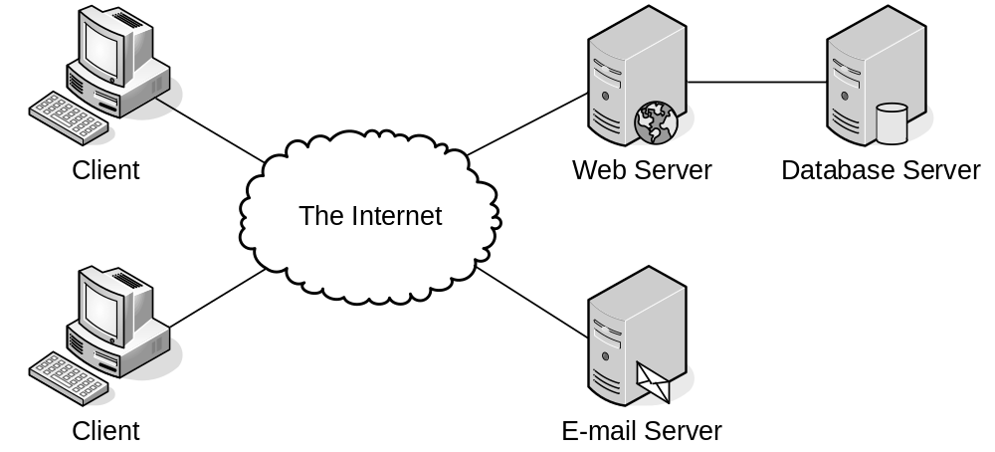

Slide 55
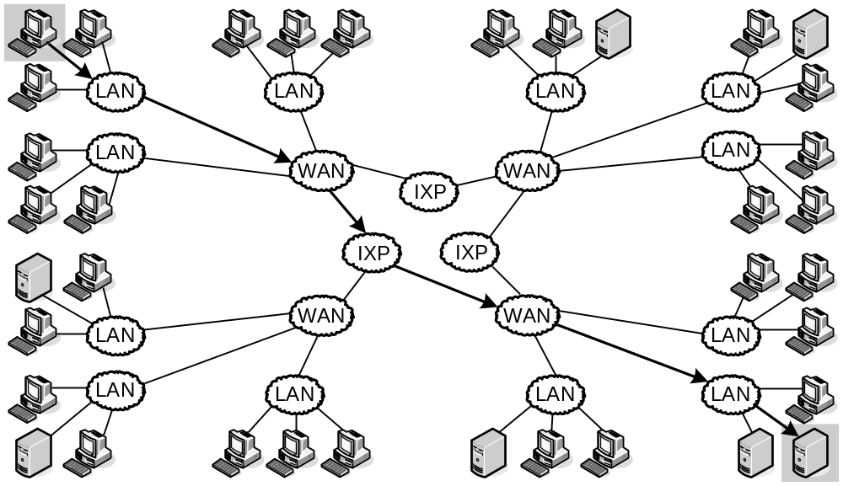

Slide 56
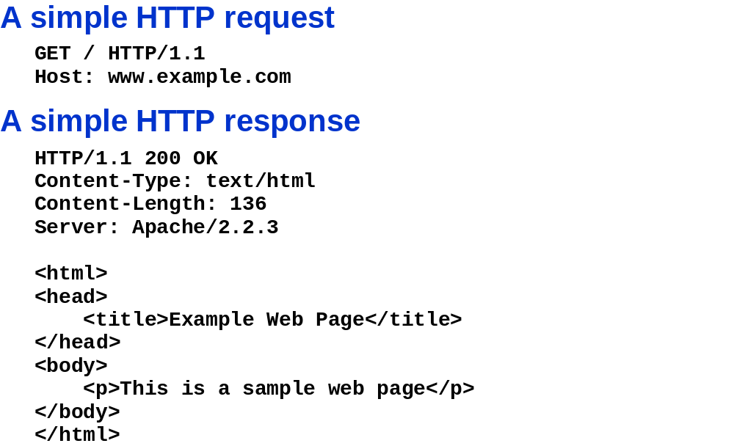

Slide 57
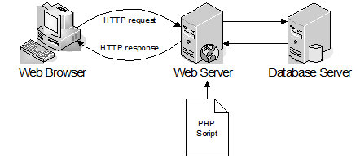
Dynamic Web Page: generated by server-side program/script
  Page can change each time viewed
    Based on user submissions or database
  Application: interactive web applications, e-commerce.

Slide 58
Logging in to MySQL
Enter the following command:
  mysql –h host –u user –p
Two accounts are created:
  Anonymous user account
    allows login without specifying a username or password
  root account
    the primary administrative account for MySQL
    created without a password
  mysql –u root
exit or quit commands
  Log out

Slide 59
Modifying User Privileges
Privileges
  actions and operations a user can perform with a table or a database
  accounts should only be assigned the MINIMUM necessary privileges to perform given tasks
    For security purposes

Slide 60
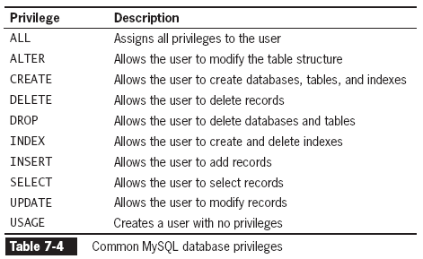
Modifying User Privileges
(continued)

Slide 61
Granting Privileges
GRANT statement:
  if account does not exist:
    creates user account
    and assigns privileges
  If account exists:
    updates the privileges
  GRANT privilege [(column)] [, privilege [(columns)]] ...
  ON {table | * | *.* | database.*}
  TO user [IDENTIFIED BY 'password'];

Slide 62
Revoking Privileges
REVOKE
  Cancels grants given
REVOKE ALL PRIVILEGES statement
  removes all privileges from a user account
    for a specified table or database
  You must be:
    logged in with the root account
    or have sufficient privileges to revoke privileges
    from another user account
The syntax for the REVOKE statement is:
  REVOKE privilege [(column)] [, privilege [(columns)]] ...
  ON {table | * | *.* | database.*}
  FROM user;

Slide 63
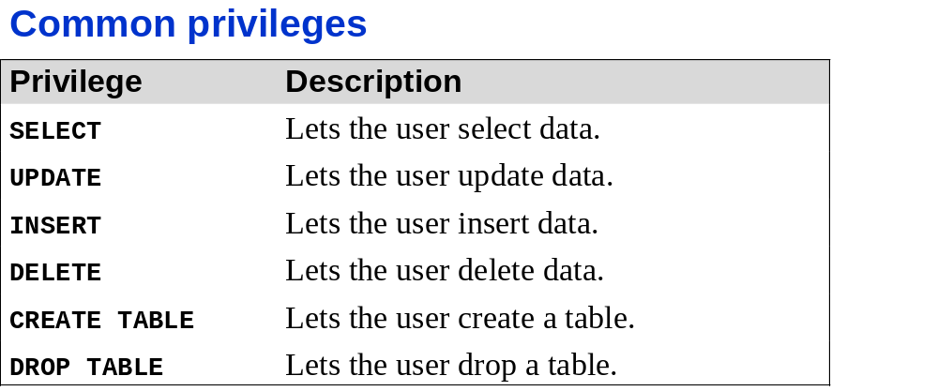
Other related Keywords
SHOW GRANTS
DROP USER

Slide 64
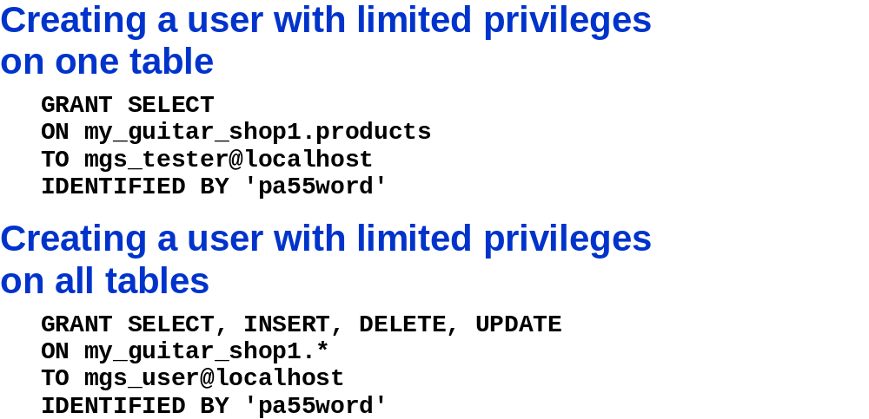
In Class Assignment
1) To the user called mgs_tester, Grant the select privilege only on the my_guitar_shop1 database and only for the products table. His server is on the localhost. His password is pa55word
2) To the user called mgs_user, Grant the select, insert, delete, update privileges only on all tables in the my_guitar_shop1 database. His server is on the localhost. His password is pa55word
Sol’n:
Creates user on localhost with the given password

Slide 65
In Class Assignment:
Login to the mgs_tester account
Check which account is loged in.
Check what grants the user has.
What database are you using?
Use the my_guitar_shop1 DB.
Read the contents of the orders table.
  What happened and why?
Read the contents of the products table.

Slide 66
In Class Assignment
Create a user name destroyer who has access to the local host and only the ability to destroy the the my_guitar_shop2 DB contents and structure. His name is his passport.
Sol’n:
GRANT DELETE, DROP
ON my_guitar_shop2.*
TO destroyer@localhost
IDENTIFIED BY 'destroyer‘

Slide 67
Encoding and Decoding a String
(continued)
md5()function
  uses the Message-Digest Algorithm
    a strong encryption algorithm
    creates a one-way hash
      one-way hash
        a fixed-length string
        - based on the entered text
        nearly impossible to determine original text from it
  does not have an equivalent decode function
    useful for storing passwords in a database
    How do you use this technology to enhance security?
      Store the hash value in DB → send entered password to md5 → compare hash values → if same then allow access

